Slide 1
Walmart Hurricane Analytics
Pre-Hurricane Demand, Weather, and Inventory Trends
DS 2002 Midterm Project
Norah Munoz, Safaa Mahbub, Prabhnoor Kaur, Samikksha Kumar
Notes:
We looked at how sales changed across 12 Florida Walmart stores before Hurricane Helene. We combined transaction, inventory, and weather data to figure out what people bought, when demand peaked, and what Walmart could stock ahead of the next storm.

Slide 2
Specific Problems
884 transactions had no timestamp, so they could not be assigned to a day
60 different store IDs for just 12 actual stores
45 SKU labels for just 20 product families
Duplicate transactions, prices stored as text, and inconsistent category names
Notes:
Before we could compare sales across stores or days, we had to clean up three problems. We had 884 transactions without timestamps, 60 versions of store IDs for 12 stores, and 45 SKU labels that we grouped into 20 product families. Without cleaning those fields, we could split sales from one store or product across several labels.

Slide 3
General Cleaning: Duplicates, Prices, Timestamps, and Categories
Duplicates
Removed 30 duplicate transactions; other tables had no duplicates
Prices
Removed dollar signs and converted unit prices from text to numeric values
Timestamps and Missing Values
Standardized inconsistent date formats using pd.to_datetime()
Retained 884 transactions with missing timestamps after duplicate removal
Excluded transactions with missing timestamps from date-based analyses, leaving 24,648 transactions with valid timestamps
Categories
Standardized category names by correcting capitalization and spacing
Notes:
We removed 30 exact duplicate transactions, converted prices to numbers, and standardized dates and category names. We kept transactions with missing timestamps in the cleaned dataset because they still counted toward totals that did not depend on dates. For daily analysis, we used the 24,648 transactions with valid timestamps.

Slide 4
Data Cleaning: 60 IDs to 12 Stores, 45 SKUs to 20 product families
Store ID Cleaning
The same store appeared under five different ID formats (FL-302, FL_302, fl-302, etc.)
Standardized capitalization, spacing, underscores, and missing dashes, reducing 60 ID variations to 12 stores
Used Tallahassee's city-center coordinates as an estimate for the weather lookup because its coordinates were missing
SKU Cleaning
Found 45 SKU labels grouped into 20 product families
Combined different SKUs for the same product into one standardized product ID
For example, Strawberry Pop-Tarts appeared under four different SKUs
Allowed sales from different SKUs of the same product to be combined accurately
Notes:
We standardized store IDs so formats like FL-302 and FL_302 matched the same store. Tallahassee was missing coordinates, so we used its city center for the weather lookup. We also mapped SKUs to product families, which let us add up demand across different labels while keeping pack sizes available for ordering.

Slide 5
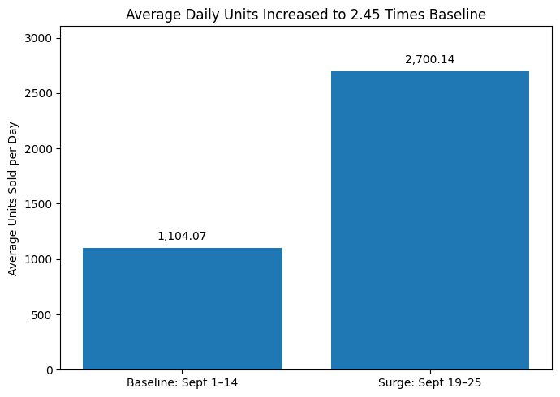
Daily Sales Reached 2.45 Times the Baseline Before Landfall
Question 1: Pre-Hurricane Demand Surge
Compared September 1–14 (baseline) with September 19–25 (surge), the week leading up to landfall
Average daily sales increased from 1,104 to 2,700 units, meaning stores sold 2.45 times as many units per day
Sales began increasing around September 15, with a much larger jump starting September 20
Sales peaked on September 25, one day before landfall, suggesting customers were stocking up as the hurricane approached
Notes:
We compared September 1–14 with September 19–25, the seven days before landfall. We used average daily sales because the windows were different lengths. Sales rose from about 1,104 to 2,700 units per day, or 2.45 times the baseline, and peaked on September 25.

Slide 6
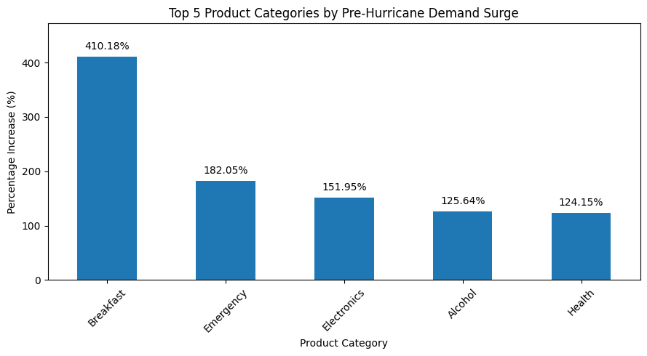
Breakfast Had the Largest Demand Surge
Compared average daily sales across product categories during the baseline and surge periods
Breakfast had the largest increase at 410.18%, more than any other product category
Emergency supplies increased 182.05%, followed by Electronics at 151.95%
Alcohol (125.64%) and Health (124.15%) also experienced significant increases
These findings suggest customers were stocking up on both essential supplies and everyday products as the hurricane approached
Question 1: Pre-Hurricane Demand Surge
Notes:
Breakfast had the largest percentage increase at 410.18%, while Emergency supplies had the highest sales volume among the five categories shown. Emergency supplies went from about 355 to 1,002 units per day. The percentage increase tells us which category changed most relative to its usual sales. The daily volume helps Walmart plan how much to stock.

Slide 7
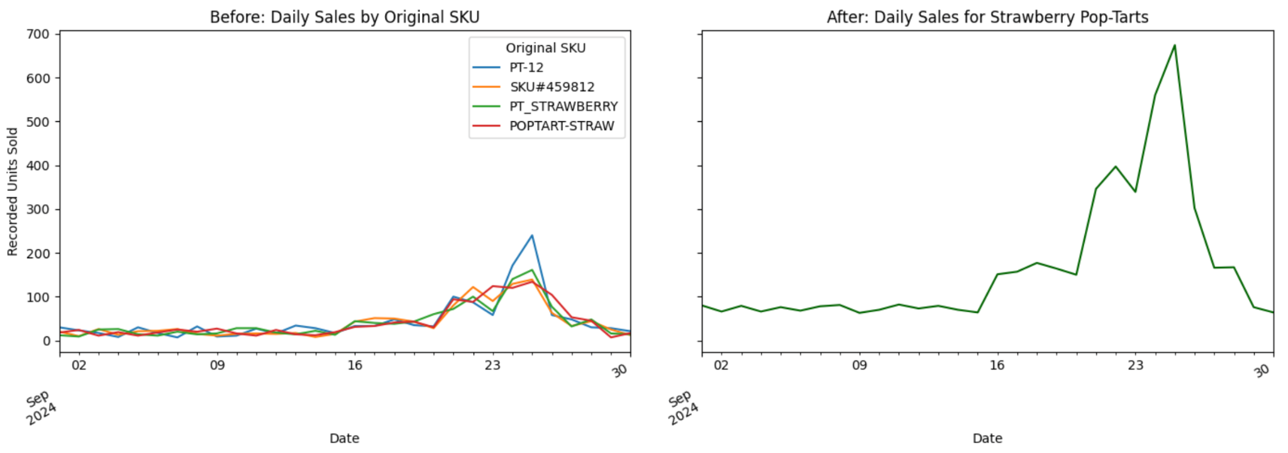
Strawberry Pop-Tarts Sales Peaked at 674 Units
Question 2 · SKU Consolidation
September 25 peak: 674 recorded units across all stores. The largest individual SKU showed 240.
Stocking decision: Use the combined total to plan overall stock and the pack-size breakdown to decide what to order.
Notes:
Strawberry PopTarts appeared under four different SKU labels. I checked the product catalog and found that three labels were for four-packs and one was for six-packs. I added up sales by day across all four labels and kept the two pack sizes separate for ordering. On September 25, the biggest individual SKU showed 240 units, but together the four SKUs accounted for 674 units. That was 540 four packs and 134 six packs. The daily chart uses transactions with usable dates. That’s why it adds up to 4,985 units, while the full dataset shows 5,178. Walmart could use the combined number to plan how much stock it needs before a storm, then use the pack-size breakdown to decide how many of each size to order.

Slide 8
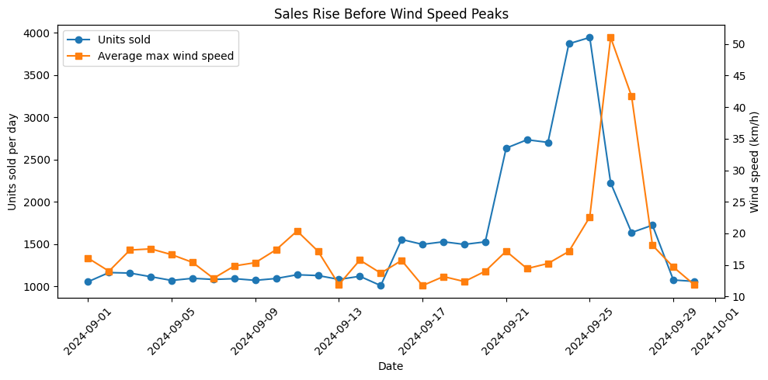
Sales Rise Before Wind Speed Peaks
Question 3: Weather Correlation
Matched daily sales with Open-Meteo weather data for all 12 stores, pulled in Eastern time to line up with the sales data
Same-day correlations over 30 days were weak (wind: 0.24, rain: -0.30, pressure: -0.28)
Takeaway: Customers stocked up ahead of the storm, so stores need to prepare early
Sales jumped Sept 21 and peaked Sept 25, a day before wind peaked on Sept 26
Sales were most strongly correlated with wind and pressure measured two days later (wind r = 0.79, pressure r = −0.74)
Notes:
We matched Open-Meteo weather with sales by store and date, using Eastern time. Across 30 days, the same-day correlations with wind, rain, and pressure were weak. Sales peaked September 25, one day before wind peaked. When we shifted the weather series, sales lined up most closely with wind and pressure measured two days later. That timing is consistent with shoppers preparing ahead of the storm.

Slide 9
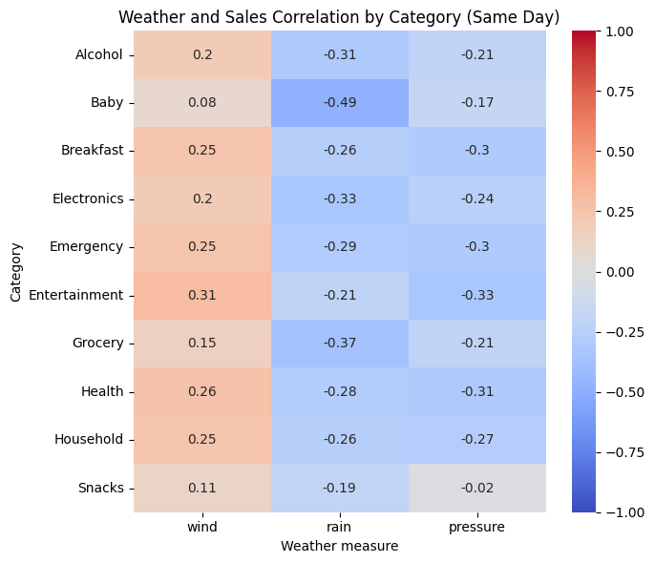
Weather Correlations Across Product Categories
Question 3: Weather Correlation
All 10 categories rise slightly with wind and fall slightly with rain and pressure
Entertainment had the strongest wind correlation (0.31), and Baby had the strongest rain correlation (−0.49)
One storm and 30 days of data are not enough to prove weather caused the sales changes
Graph: Each number shows how closely a category's daily sales move with that weather measure on the same day. Red means they rise together, blue means they move opposite, and near 0 means little relationship.
Notes:
The heatmap shows same-day correlations across 30 days. All ten categories had positive correlations with wind and negative correlations with rain and pressure. Entertainment had the strongest wind correlation at 0.31, and Baby had the strongest rain correlation at −0.49. These are patterns from one storm, so we can describe how sales and weather moved together.

Slide 10
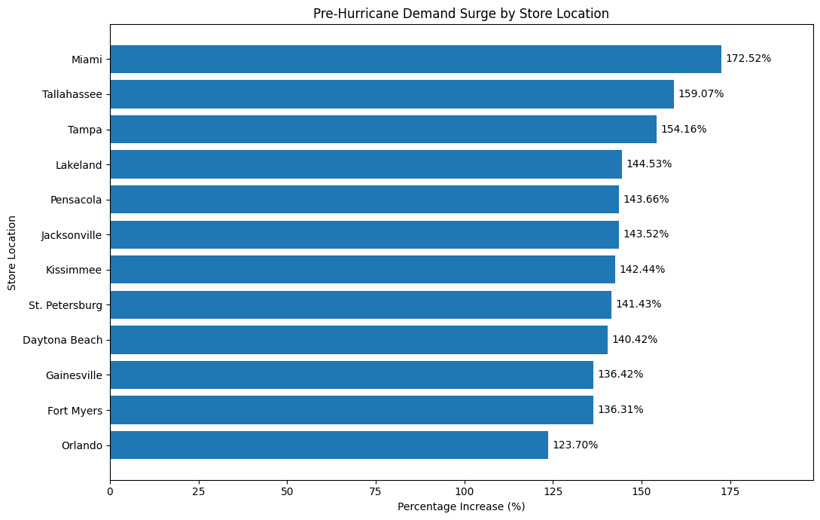
Miami Had the Largest Store-Level Demand Surge
Question 4: Geographic Demand Comparison
Compared average daily units sold across 12 Walmart stores during the baseline and surge periods
All 12 stores experienced an increase in demand before the hurricane
Miami had the largest increase at 172.52%, followed by Tallahassee (159.07%) and Tampa (154.16%)
Orlando had the smallest increase at 123.70%, but its average daily sales were still 2.24 times the baseline
Six stores peaked September 24 and six peaked September 25. Stores closer to Helene’s forecast track showed no clear pattern of earlier peaks or larger surges.
Notes:
We compared average daily sales from September 1–14 with September 19–25, the week before landfall. Then we used the National Hurricane Center’s September 25 forecast to estimate each store’s distance from Helene’s predicted path. Tallahassee was the closest and peaked on September 24. Miami was the farthest, peaked on the same day, and had the largest increase at 172.52%. Across all 12 stores, the correlation between distance and surge size was 0.11. Based on this storm, distance alone would have been a poor guide for deciding which stores needed extra inventory.

Slide 11
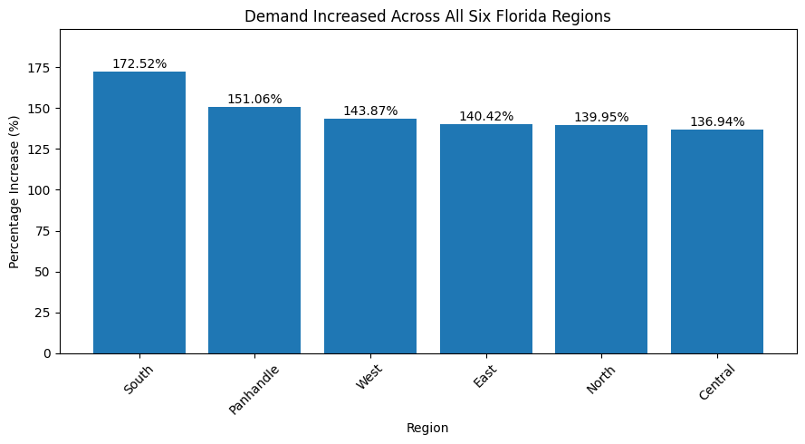
South Florida Had the Largest Regional Demand Surge
Question 4: Geographic Demand Comparison
South Florida had the largest increase at 172.52%, followed by the Panhandle (151.06%) and West (143.87%)
East (140.42%) and North (139.95%) also experienced substantial increases.
Central Florida had the smallest increase at 136.94%, but demand still more than doubled compared to the baseline.
These findings suggest that pre-hurricane shopping increased throughout Florida, although the size of the increase varied by region.
Compared average daily units sold across the six Florida regions during the baseline and surge periods.
All six regions experienced an increase in demand before the hurricane.
Notes:
Average daily sales increased in all six regions. The South region had the largest percentage increase at 172.52%, and Central had the smallest at 136.94%. Miami was the only store in the South region in our dataset, so that regional figure reflects Miami’s sales.

Slide 12
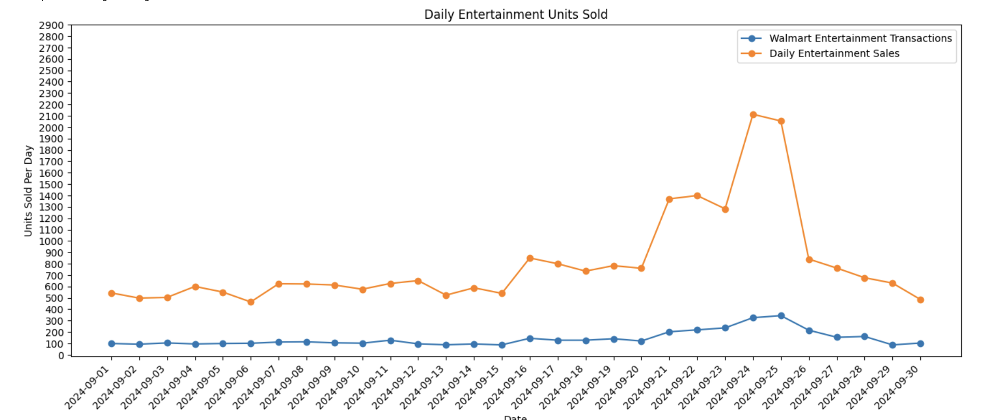
Q5: Signal vs. Artifact: The Board Games Investigation
Sales evidence:
Daily sales increased by 224.58%(~560 to ~1817 units/day)
Cross Reference with walmart transaction:
Increased by 194.92%(~102 to 302 units/day)
Shows a substantial increase, but neither data sources have an +250% increase in sales
Periods chosen:
Baseline: September 1-10th, 2024
Surge period: September 23 - 25th, 2024
Notes:
We compared average daily Entertainment sales in the SQLite summary and the transaction records. The SQLite summary showed a 224.58% increase, and the transaction records showed a 194.92% increase. Both sources point to a real increase in demand, though the size of the increase varies by source.

Slide 13
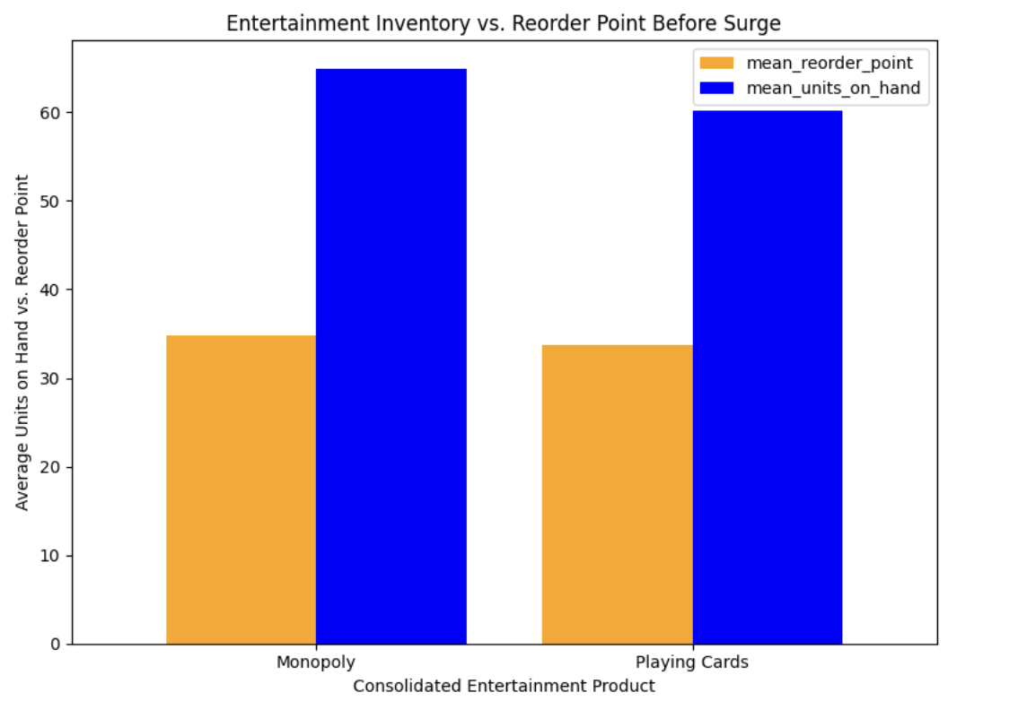
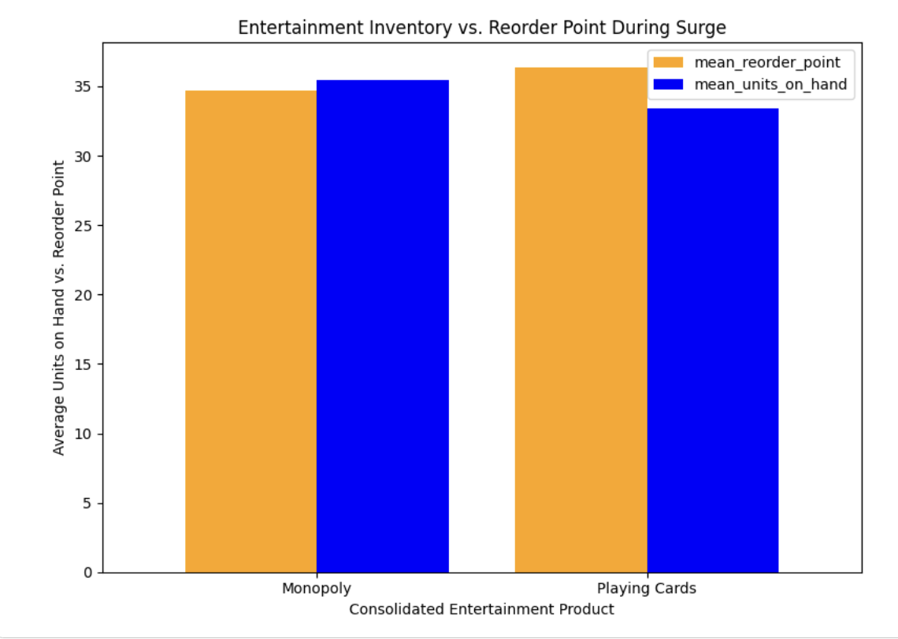
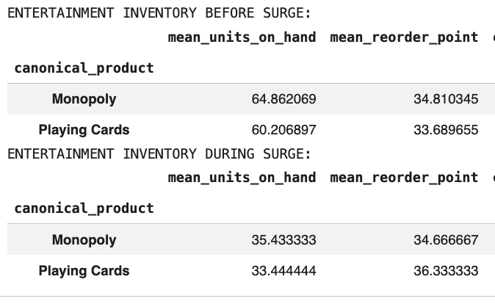
Q5: Signal vs. Artifact: The Board Games Investigation
√
Inventory comparison: September 5–10 versus September 23–25, 2024
Monopoly:
  Mean units on hand: 64.86 → 35.43 units
  Mean reorder point during surge: 34.67 units
Playing Cards:
  Mean units on hand : 60.21→33.44 units
  Mean reorder point during surge: 36.33 units
Playing cards averaged 33.44 units on hand during the surge, below their average reorder point of 36.33. Monopoly averaged 35.43 units on hand, slightly above its reorder point of 34.67.
Notes:
We checked inventory to see which products were under the most pressure. Both had lower stock during the surge, and playing cards fell below their average reorder point. That’s why we recommend a modest increase in playing card stock before the next storm and closer monitoring of Monopoly inventory.

Slide 14
Recommendations
Stock stores about 5 days before landfall, ahead of the expected increase in demand.
Focus on Breakfast (5.1x normal sales) and Emergency supplies (~1,000 units/day vs. 355 normally).
Prioritize Miami, Tallahassee, and Tampa, which saw some of the largest sales increases.
Forecast demand by product family and place orders by pack size
Increase playing card stock modestly and monitor Monopoly inventory.
These recommendations are based on one storm and 30 days of data, so they should be checked against future storms.
Notes:
Based on this storm, we’d start stocking about five days before expected landfall, with extra attention to Breakfast and Emergency supplies. We’d use each store’s past sales surge to guide allocation and increase playing card stock modestly while monitoring Monopoly inventory. We’d check these patterns against future storms before making them a standard policy.
One problem we ran into was treating all four Strawberry Pop-Tarts labels as interchangeable. Checking the product catalog showed that three labels were for four-packs and one was for six-packs. We learned to use the combined total to estimate overall demand and keep the pack sizes separate when deciding what to order.

